Slide 1

How to Study Power BI Effectively and Pass Your PL-300
Katrina Durance

Slide 2

Why I Created This Presentation
Second career
Accidental techie
No previous tech experience
Basic first training
Research geek
Notes:
Started from zero
Only reporting and DAX – fine for first consulting since I was with the same client
3Cloud – discovered gaps
Research helped me find resources to fill gaps

Slide 3
Who Is This Presentation For?
Newbies
Dabblers
Notes:
People who are brand new to Power BI and want to learn more
Like me, people who may have learned reporting basics on their own or at work and want to dig deeper

Slide 4
What We Will Review
Overview of Key Power BI Study Topics
Study Plan for the PL-300 Certification

Slide 5
A list of resources, for all Power BI topics and the PL-300 study guide, will be provided in a separate document.

Slide 6
Power Bi study topics

Slide 7
Where to Access Power BI
Power BI Desktop
Power BI Service
Power BI Mobile
Power BI Embedded – advanced topic
Notes:
Cloud
Local machine
Mobile devices
Can be embedded in apps, web pages, Power Point, etc.

Slide 8
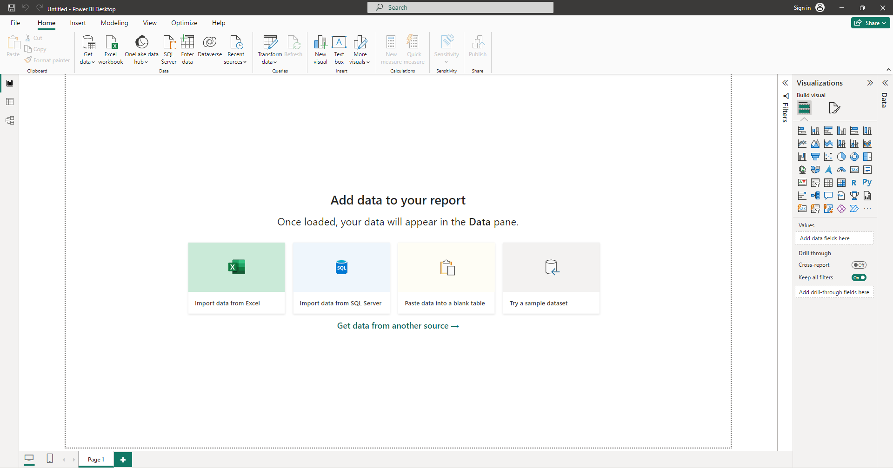
Power BI Desktop
Notes:
Canvas for report building on local machine

Slide 9
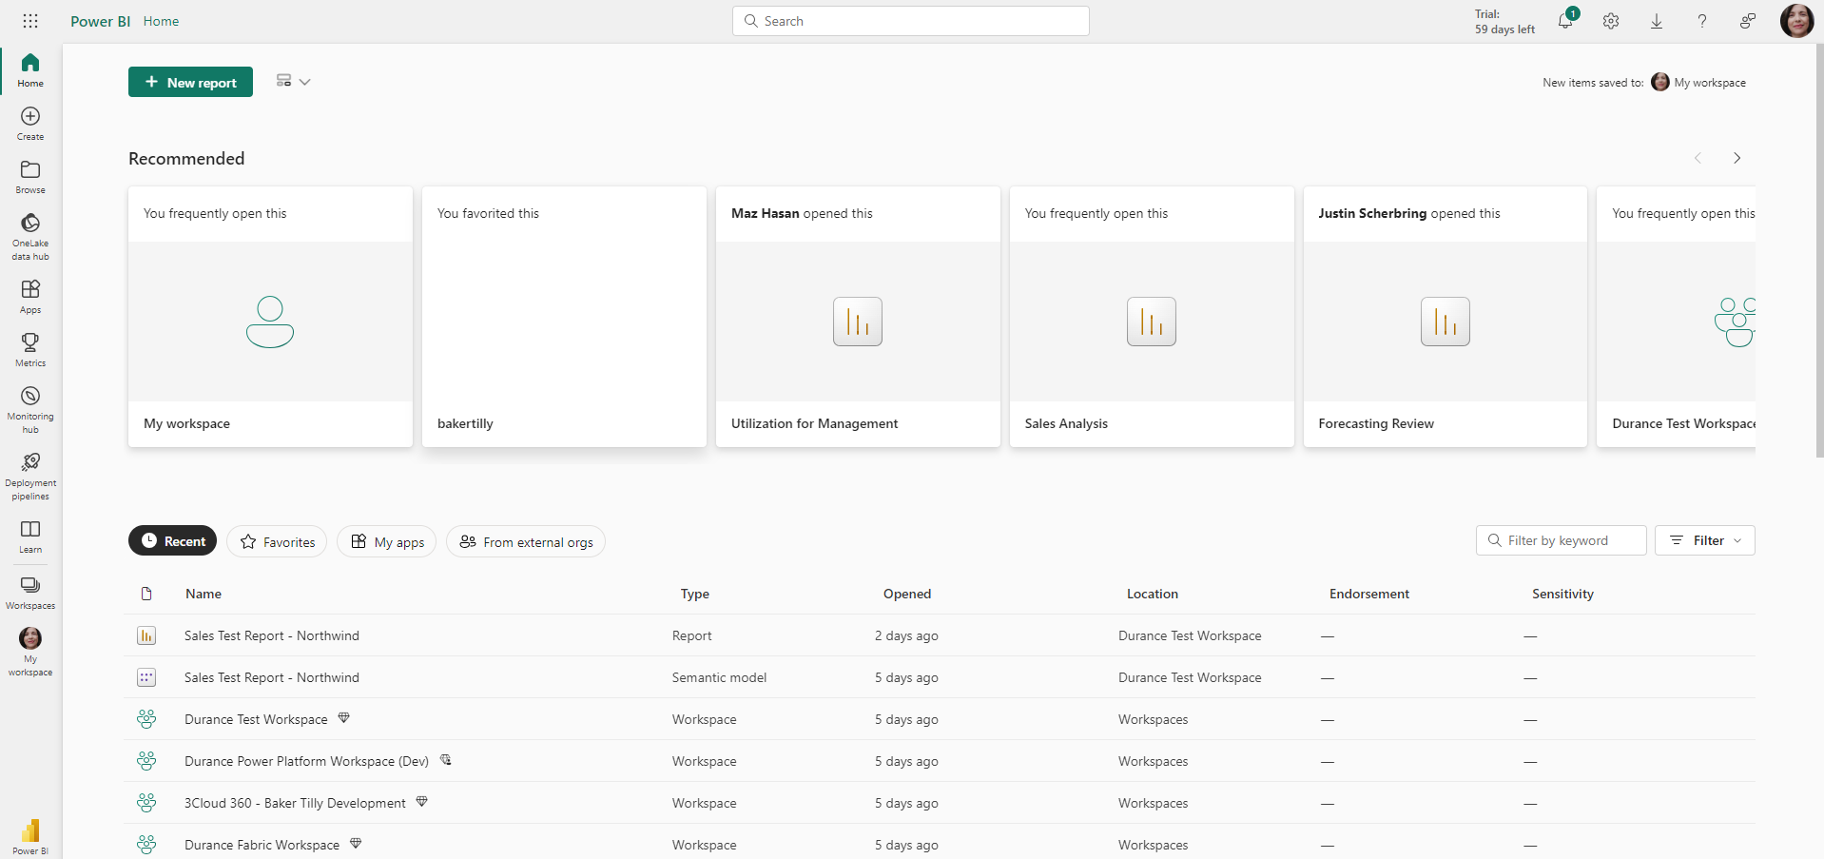
Power BI Service
Notes:
Home page for the cloud service
Can develop reports in the service but desktop currently has most functionality

Slide 10
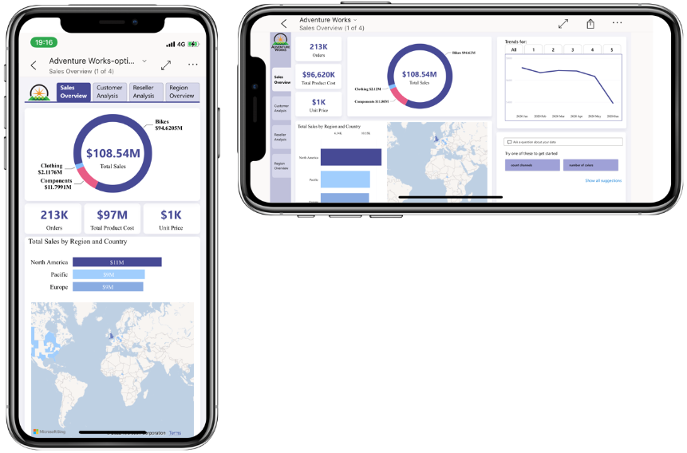
Power BI Mobile
Notes:
Pocket Power BI access
Can tailor reports for mobile viewing in desktop and service

Slide 11
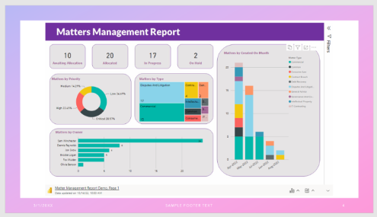
Power BI Embedded
Notes:
Power BI report embedded in a Power Point slide

Slide 12
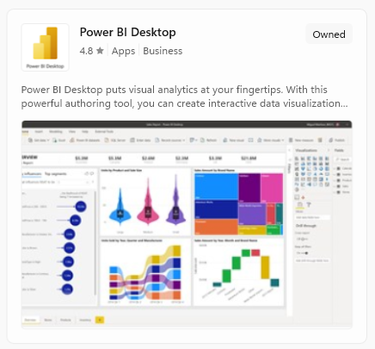
Download the Software
Download Power BI Desktop for free
Two download options:
Microsoft Store (ideal) →
Manual
Notes:
Ideal – updates are automatic
Requires monthly manual updates

Slide 13
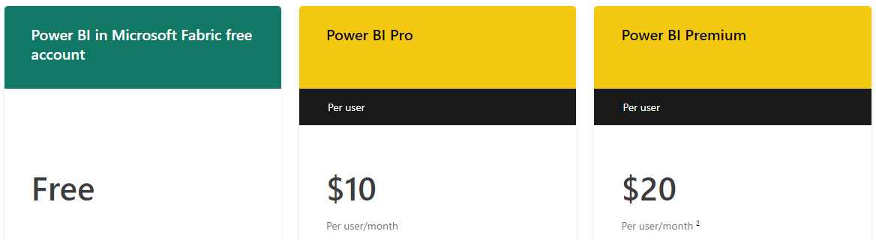
Licenses
Three license options:
Free
Pro
Premium per user
60-day free Pro trial
Notes:
Pro – allows you to publish from desktop
Premium – access to even more features

Slide 14
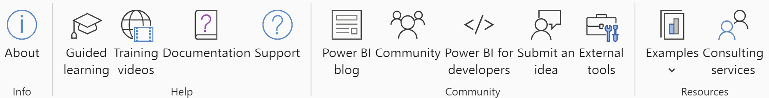
Get to Know the Software
Familiarize yourself with the interface
Options available in multiple places
Help ribbon
Notes:
Click all over and work to understand what each piece does
You’ll learn what places you prefer to access a given option
Quick access to Microsoft Learn, the Power BI documentation, blog, Community for submitting questions, report and data samples in Examples

Slide 15
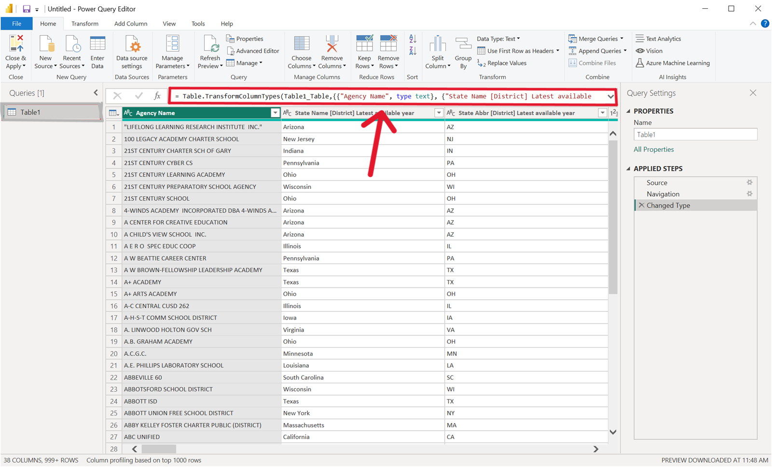
Import and Transform Data
Connect to different types of data sources
Import data using:
sample datasets in Power BI
free datasets online
your own data
Power Query
M Language
Notes:
Many data connectors to all types of sources across the board
Sample data under Help → Examples
100K + free datasets on the web
Environment for cleaning and shaping data
Data transformation language used in Power Query

Slide 16
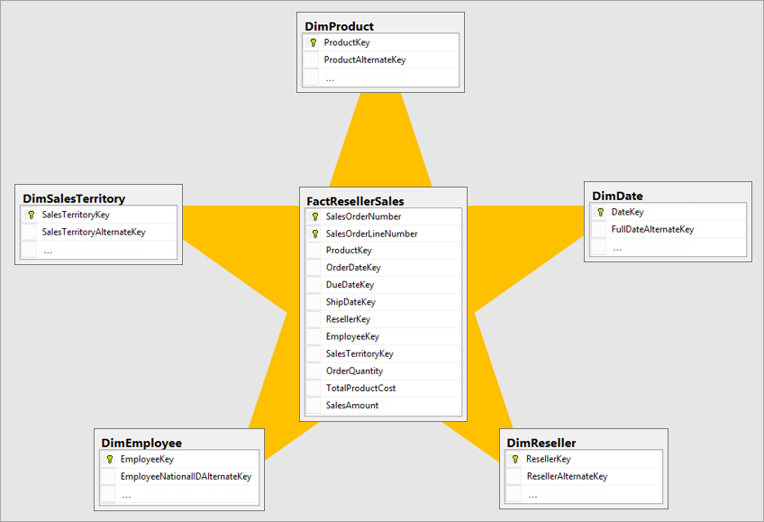
Semantic Modeling & DAX (formerly data modeling)
Dimensional modeling
DAX:
Calculate approach
No calculate approach
TIP: DAX performs best with a well-designed dimensional model.
Notes:
Name was recently changed by Microsoft
Understand how to break your data into dimension and fact tables and create relationships between them to create a star schema
DAX is the formula language used to create calculations in your report visuals among other things
Learn both approaches and decide which is better for you
If you missed it, listen to the recording of Greg Deckler’s DAX for Humans talk to this group a couple weeks ago
Good model design speeds up reports and simplifies DAX measures

Slide 17
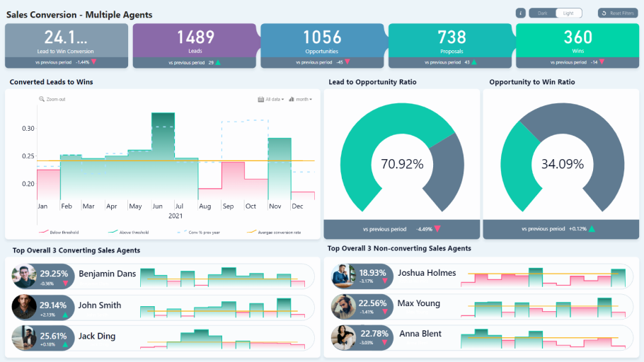
Reporting
Requirements
Report design
Visuals
Report building
Data storytelling
Notes:
How and when to use different visuals
Providing insights into a client’s data using an engaging story

Slide 18
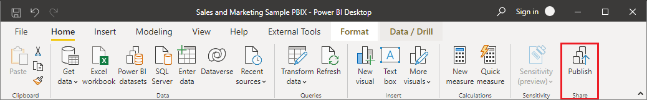
Publish and Share
Workspaces
Publish reports
Refreshes
Report permissions
TIP: Avoid using your personal My Workspace for sharing.
Notes:
Environment in the service where reports can be shared with others
Publish to the service
Schedule data to be refreshed as needed so data stays current
Give individuals or groups access to the report

Slide 19
Stay Up to Date
Continuously evolving
Updated monthly
Review new features
Try public preview features
Notes:
Power BI blog and YouTube channel showcase new features for every update
Copilot and on-object editing – gives head-start before going into general availability

Slide 20
Pl-300 Certification microsoft power BI Data Analyst study plan

Slide 21
What is the PL-300?
Professional certification
Intended for business or data analyst roles
Must be renewed annually
Open book, but don’t be fooled
Notes:
Renewal is much easier – only a free assessment on Microsoft Learn
Eats into test time, can distract from preparing well and working to actually understanding the material

Slide 22
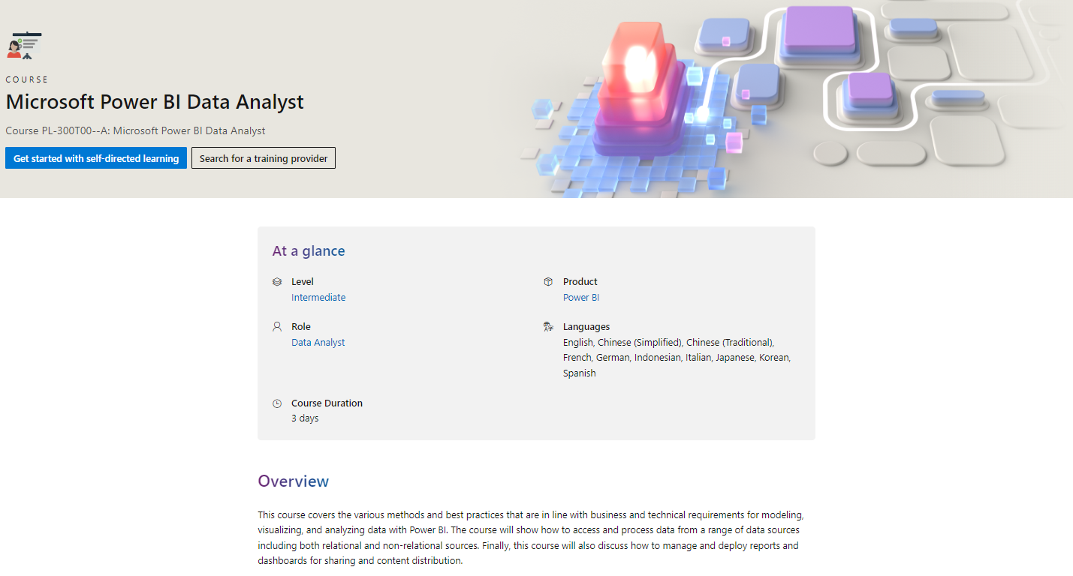
Microsoft Learn Learning Paths
X
Notes:
Excellent trainings
Best place to start then add supplemental resources
Duration much longer than 3 hours

Slide 23
Personal Projects
Treat these as if working for a client
Requirements
Get data
Connect to data
Power Query
Notes:
Need to actively use Power BI
Necessary for interviews if no experience

Slide 24
Personal Projects continued
Semantic (data) model
Build report – use DAX, visuals, other options
Get feedback from user group member or create post in the Power BI forum
Notes:
Create dimension and fact tables and a star schema
Like buttons, page navigation, tooltips, etc.
Even better do some data storytelling with someone you know, will help in interviews

Slide 25
Practice Tests
Free official Microsoft practice test
Udemy
Sales regularly
Look for the highest ratings
Read a few negative comments
Notes:
Need to be familiar with different types of questions like multiple choice, case studies, fill in the blank
Can take practice test as many times as you like
Don’t pay full price
With a large number of ratings
Look for red flags or confirm if they’re actually similar to the Microsoft practice test

Slide 26
Additional Information
Microsoft study guide
Schedule test
Not free, cost is $165
Log in 30-45 minutes ahead of the exam and follow the instructions exactly
An exam proctor may contact you with additional questions
Notes:
Use it as your guide, contains additional helpful resources
Not inexpensive
This is common, just follow their instructions

Slide 27
What We Learned
Power BI is more than just report building
Key topics to learn as someone new(er) to Power BI
Study plan for the PL-300 certification

Slide 28
Final Thoughts
Be patient on your learning journey
Don’t compare
Create structured, reserved focus time
Select resources that resonate with you
Organize your resources
Notes:
Understanding these topics will likely take longer than you think
Only compete with yourself, you will know more than others and other will know more than you, that’s the reality
Especially if you’re neurodiverse
Not everyone learns the same way – try one then move on if it’s not helpful
Screenshot of how I organize my resources in the resource slides

Slide 29


Thank you!
Katrina Durance
Power BI Consultant – 3Cloud
katrina.durance@gmail.com
Feel free to reach out to me with questions or if you would like more resources.

